Slide 1

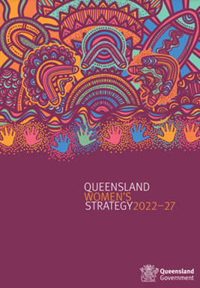
Queensland Government’s Policy Commitment to Gender-Aware Budgeting
Queensland Women’s Strategy 2022-27
Priority area - Economic Security - Commitment 2:
  Enhancing gender-aware budgeting approaches in the Queensland Government and work to ensure gender impacts are considered in policy and decision-making
Notes:
Note the impending MoG changes

Slide 2
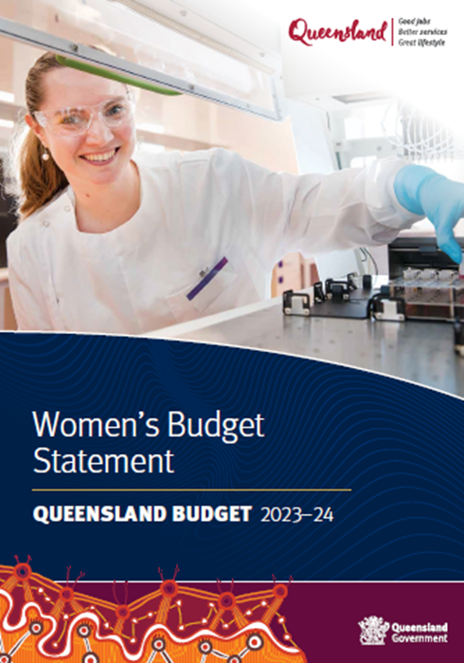
2023-24 Women’s Budget Statement
Gender Responsive Budgeting Approach
2023-24 Women’s Budget Statement applied a new assessment process to identify if budget bids aligned with the priorities of the Queensland Women’s Strategy.
This included:
  Workshopping through budget bids to identify potential gender impacts
  Assessing budget bids in terms of impact and priority for women and girls
  Identifying that there was further investment and work required to meet designed policy responses
Notes:
Note the impending MoG changes

Slide 3
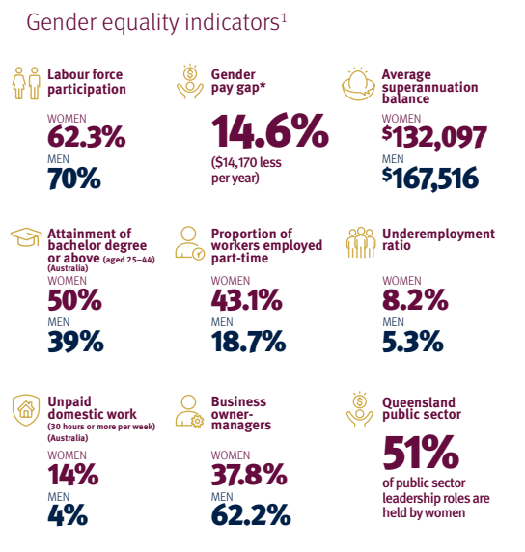
2023-24 Women’s Budget Statement
Women’s Economic Outcomes
Newly included:
  High-level summary of publicly available data
  Discussed underlying drivers of women’s economic outcomes
This economic analysis focused on three themes:
  Women’s workforce participation
  The gender pay gap
  Women’s economic security in retirement
Notes:
Note the impending MoG changes

