Slide 1
Wellbeing budgeting: the Aotearoa New Zealand experience
Hon Dr Deborah Russell Labour Member of Parliament

Slide 3
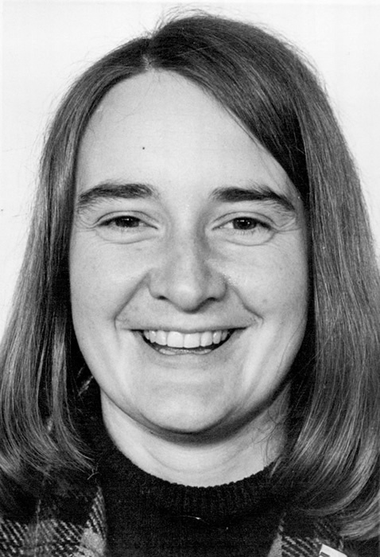
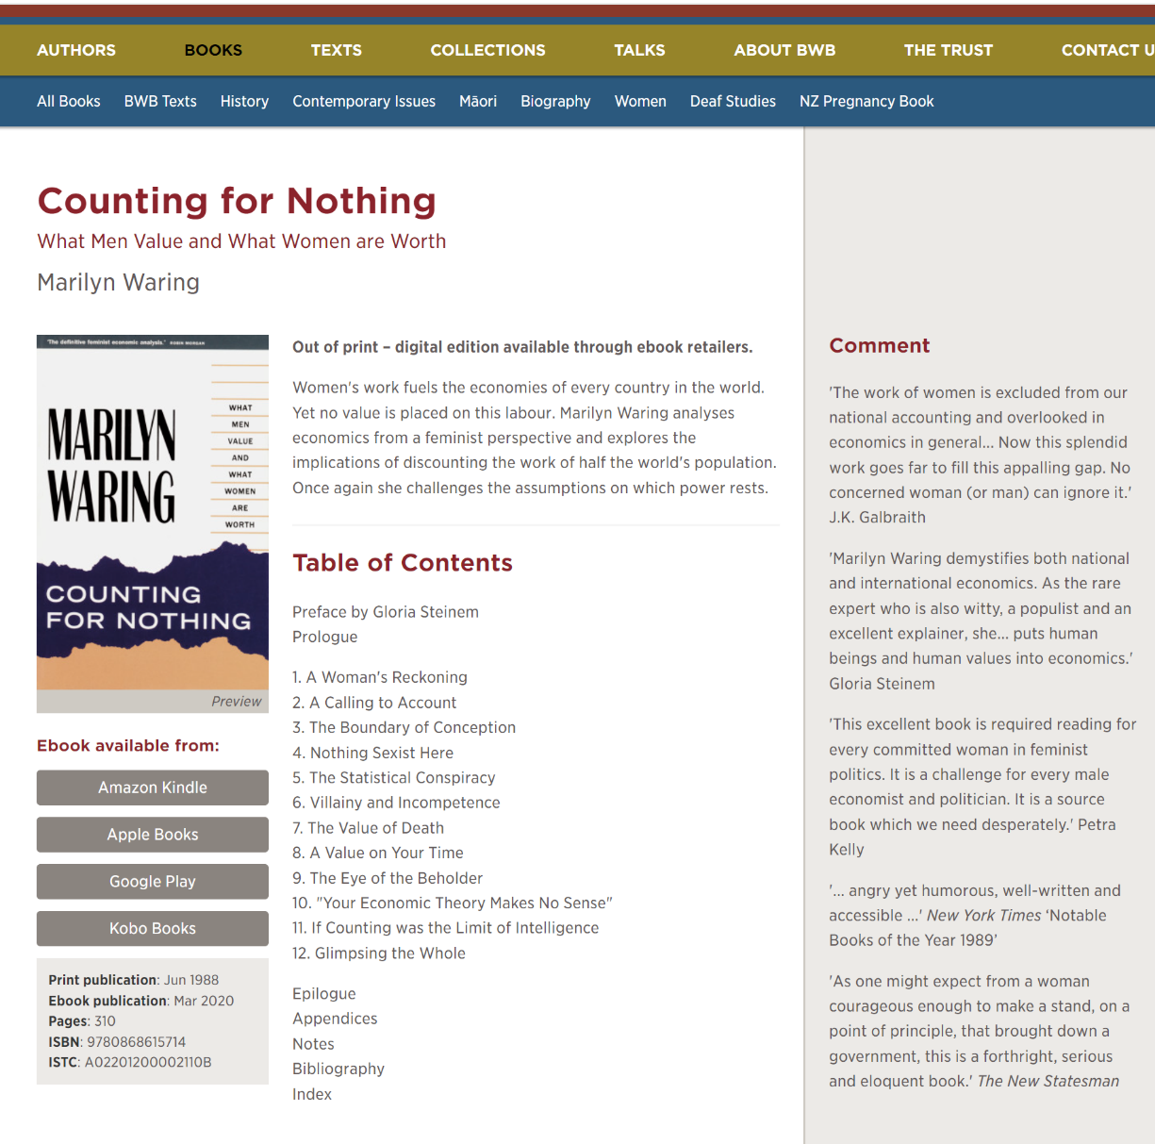

Slide 4
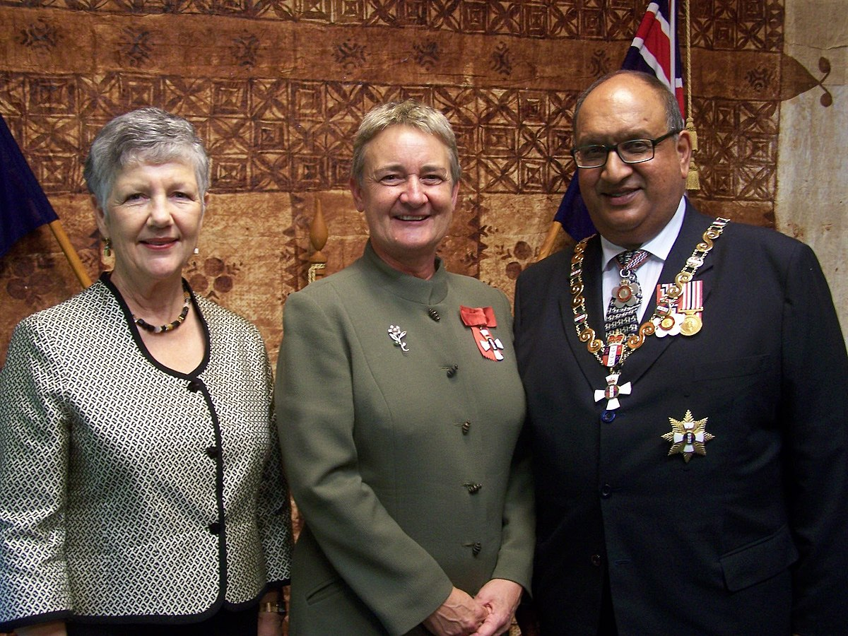
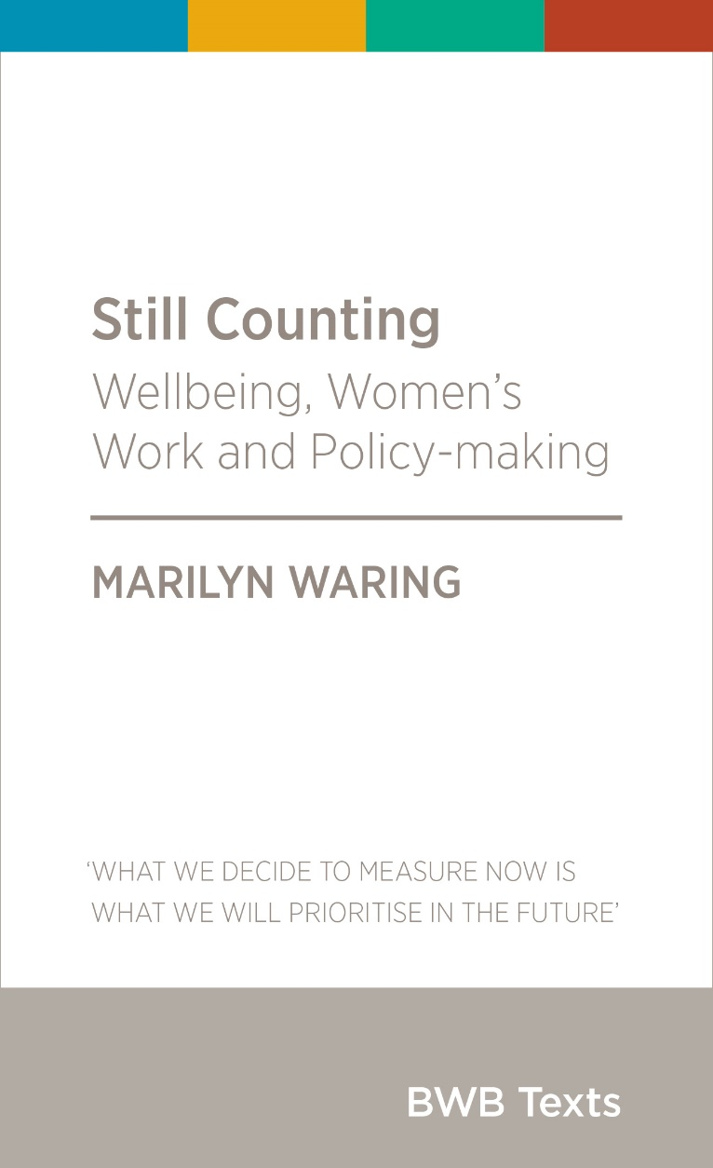

Slide 5
Too much and for too long, we seemed to have surrendered personal excellence and community values in the mere accumulation of material things. Our Gross National Product, now, is over $800 billion dollars a year, but that Gross National Product - if we judge the United States of America by that - that Gross National Product counts air pollution and cigarette advertising, and ambulances to clear our highways of carnage. It counts special locks for our doors and the jails for the people who break them. It counts the destruction of the redwood and the loss of our natural wonder in chaotic sprawl. It counts napalm and counts nuclear warheads and armoured cars for the police to fight the riots in our cities. It counts Whitman’s rifle and Speck’s knife, and the television programs which glorify violence in order to sell toys to our children.
Yet the gross national product does not allow for the health of our children, the quality of their education or the joy of their play. It does not include the beauty of our poetry or the strength of our marriages, the intelligence of our public debate or the integrity of our public officials. It measures neither our wit nor our courage, neither our wisdom nor our learning, neither our compassion nor our devotion to our country, it measures everything in short, except that which makes life worthwhile.
Robert F. Kennedy, Remarks at the University of Kansas

Slide 6
Wellbeing budgeting in Aotearoa New Zealand
Introduced by the 5th Labour government in Budget 2019
Building on the NZ Treasury’s existing Living Standards Framework
Leading up to the 2019 Budget, there was a 2018 Finance and Expenditure Select Committee briefing on the framework

Slide 7
The Living Standards Framework
Successive iterations since 2011, in a programme of work dating back to around the turn of the century
Four capitals:
Natural
Social
Human
Financial and physical

Slide 9
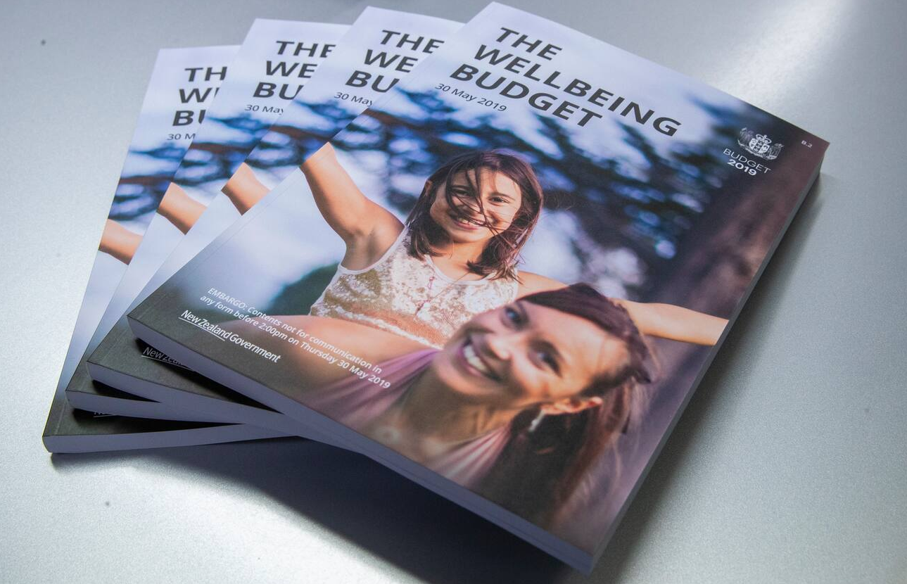

Slide 10
What made the process different?
Traditional process
Cabinet agrees to broad priorities
Ministers and agencies develop initiatives
Treasury assesses initiatives with a focus on value for money and strategic alignment
Cabinet agrees to a final package
Budget documents present the final package

Slide 11
What made the process different?
Wellbeing process
Cabinet agrees to wellbeing priorities
Ministers and agencies develop initiatives
Treasury assesses initiatives using the living standards framework
Cabinet agrees to a final package that supports wellbeing outcomes
Budget documents present the final package
Impact analysis inform evidence based priorities in future budgets

Slide 12
Traditional budget process

Slide 13
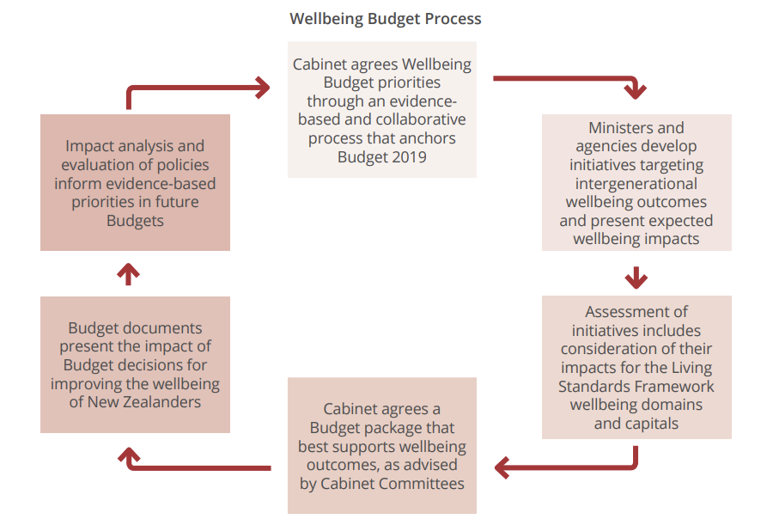
Wellbeing budget process

Slide 14
Subsequent budgets
Covid budgets
NIWE budget
Government has changed from Labour-led to National led and the 2024 budget is being developed by a new Minister of Finance
Indications are that the new minister will meet the letter of the wellbeing requirements in the Public Finance Act.

Slide 15
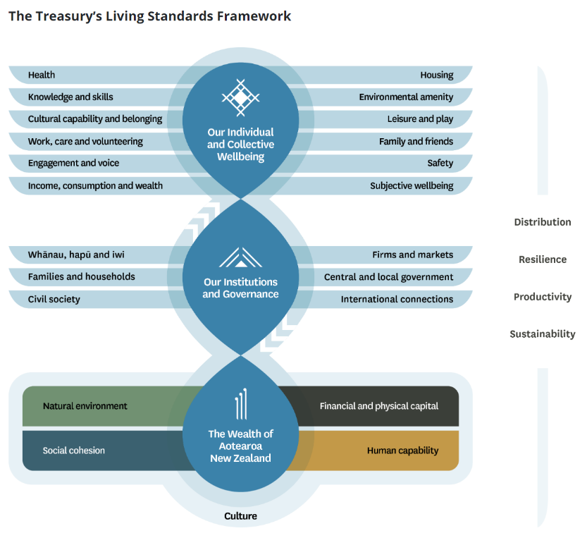
Treasury has continued to develop its living standards framework
In addition to the four capitals, the framework now considers our institutions and governance, and our individual and collective wellbeing, assessed through lenses of distribution, resilience, productivity, and sustainability.

Slide 16
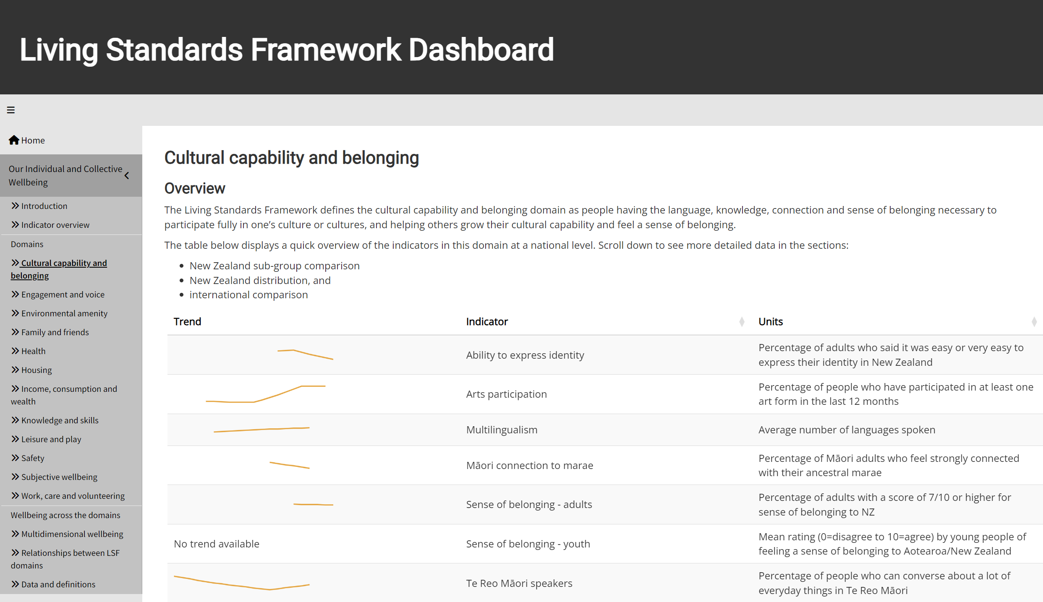

Slide 17
Further information
Living standards framework:
https://www.treasury.govt.nz/information-and-services/nz-economy/higher-living-standards/our-living-standards-framework
Living standards framework dashboard:
https://www.treasury.govt.nz/information-and-services/nz-economy/higher-living-standards/measuring-wellbeing-lsf-dashboard

