Slide 1
Session 5: Was the Minister’s decision reasonable and appropriate?
Sandra Labuschagne, Deputy Auditor General of Western Australia
audit.wa.gov.au
Copyright of Office of the Auditor General for Western Australia

Slide 2
Legislation and history
Section 82 of the Financial Management Act 2006
Section 24 of the Auditor General Act 2006
Since then, the Auditor General has tabled more than 220 opinions

Slide 3
Notifications per year since 2012-13

Slide 4
Types of section 82 notifications

Slide 5
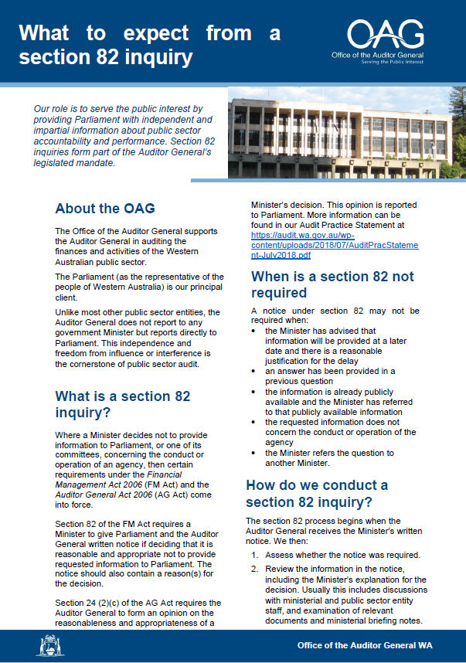
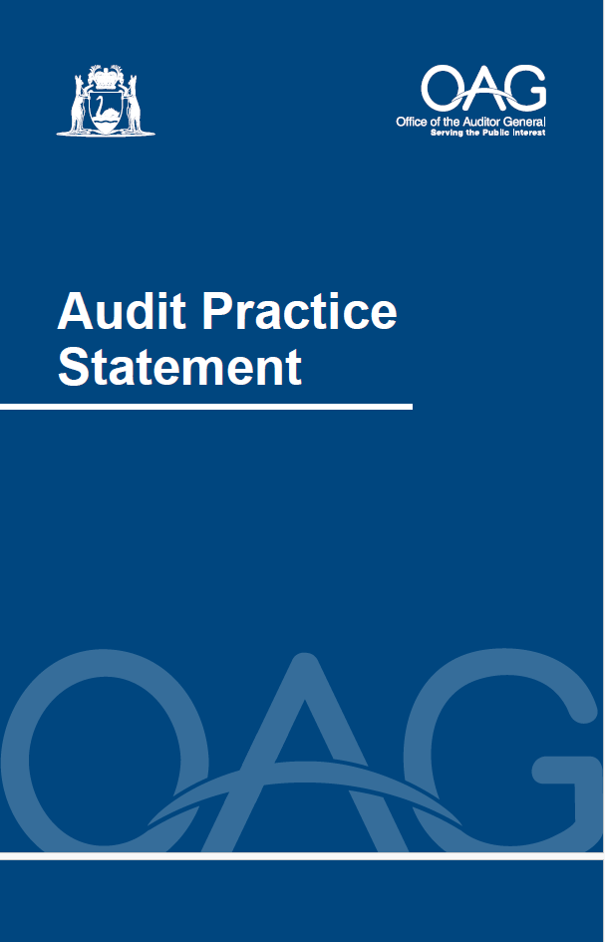
Audit office process

Slide 6
Points of interest
Access to information has been an issue – legal professional privilege
Ministers rely on entities to provide advice to assist them in making decisions, including the provision of information to Parliament.

