Slide 1
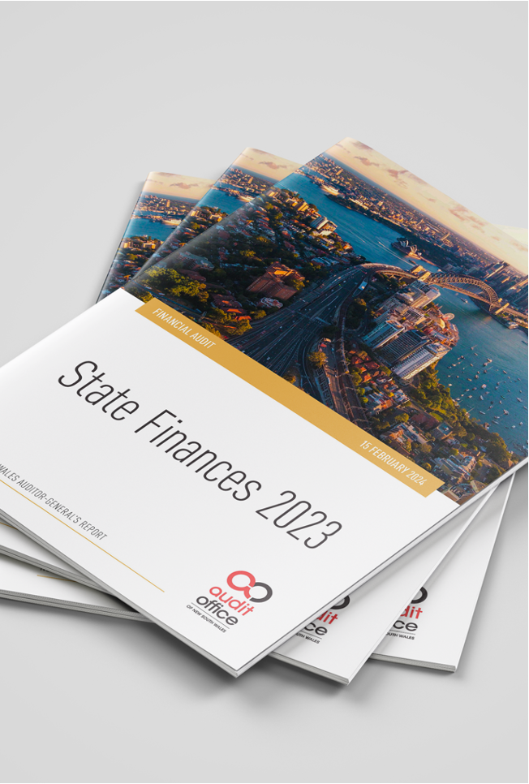
The state of
State finances
Experiences with qualified audit opinions – a NSW perspective
Bola Oyetunji - Auditor-General for New South Wales
Presentation to the Australasian Council of Public Accounts Committees – April 2024

Slide 2
Acknowledgement of Country
Artwork: ‘Yarning Circle’ by Caitlin Liddle, Audit Office Indigenous internship program participant, used with permission.

Slide 3
200 years
of auditing
...and counting
For 200 years, the Audit Office of New South Wales has been conducting audits on behalf of the Auditor-General
Our opinions on the State’s accounts have been mostly unmodified, but there have been recent qualifications
Decision to qualify requires consideration of whether matters are material
2024
1824

Slide 4
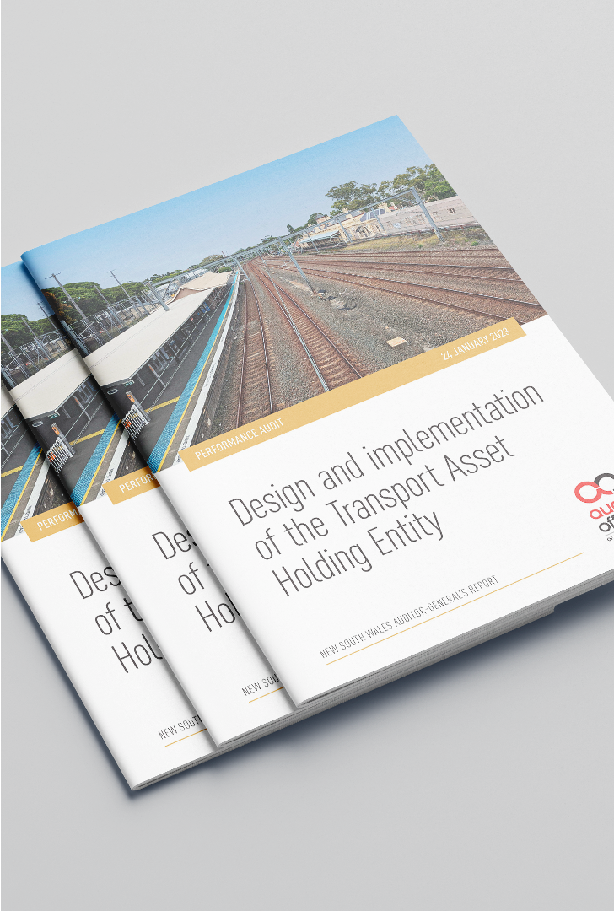
Materiality and impact of audit risk
Materiality is impacted by audit risk
Factors that increase audit risk can lower the materiality set for an audit
In recent years, several factors have increased audit risk relating to our audit of the State’s accounts, including:
history of accounting errors
withholding of relevant accounting information (extreme risk finding)
high risk management letter findings relating to TAHE, CMCT and SLMs/CTs
Ministerial requests to conduct performance audits on component entities
increased expenditure and government response relating to emergencies and natural disasters
performance audits identifying significant deficiencies in grants administration

Slide 5
Qualification matters impacting audit opinion on the 2022-23 NSW state accounts
These issues were reported to Parliament
Qualification matter 1: inability to obtain sufficient appropriate audit evidence to support the amounts recorded in the state accounts relating to the Catholic Metropolitan Cemeteries Trust (CMCT)
Qualification matter 2: inability to obtain sufficient appropriate audit evidence to support the non‑land assets, liabilities, income and expenses of Statutory Land Managers (SLMs) and Commons Trusts (CTs) that have not been recognised in the state accounts

Slide 6
Learnings from qualifications
Preparer's role – timely response to issues
Active listening by all
Role of public service to ensure compliance with law
Provision of all information
Governance processes
Active constructive consultation
Role of Parliament and PAC
Maintaining objectivity, independence and resilience
Reflective view on assessment of risk and materiality

Slide 7
Questions

