Slide 1
Closing the Gap: a Victorian parliamentary committee perspective
ACPAC 21-23 April 2024

Slide 2
I would like to acknowledge that I am making this presentation on the lands of the Whadjuk Noongar people and I wish to acknowledge them as Traditional Owners. I would also like to pay my respects to their Elders, past and present; and Aboriginal Elders and First Nations people of other communities who may be here today.

Slide 3
PAEC’s role in scrutinising financial and performance outcomes

Slide 4
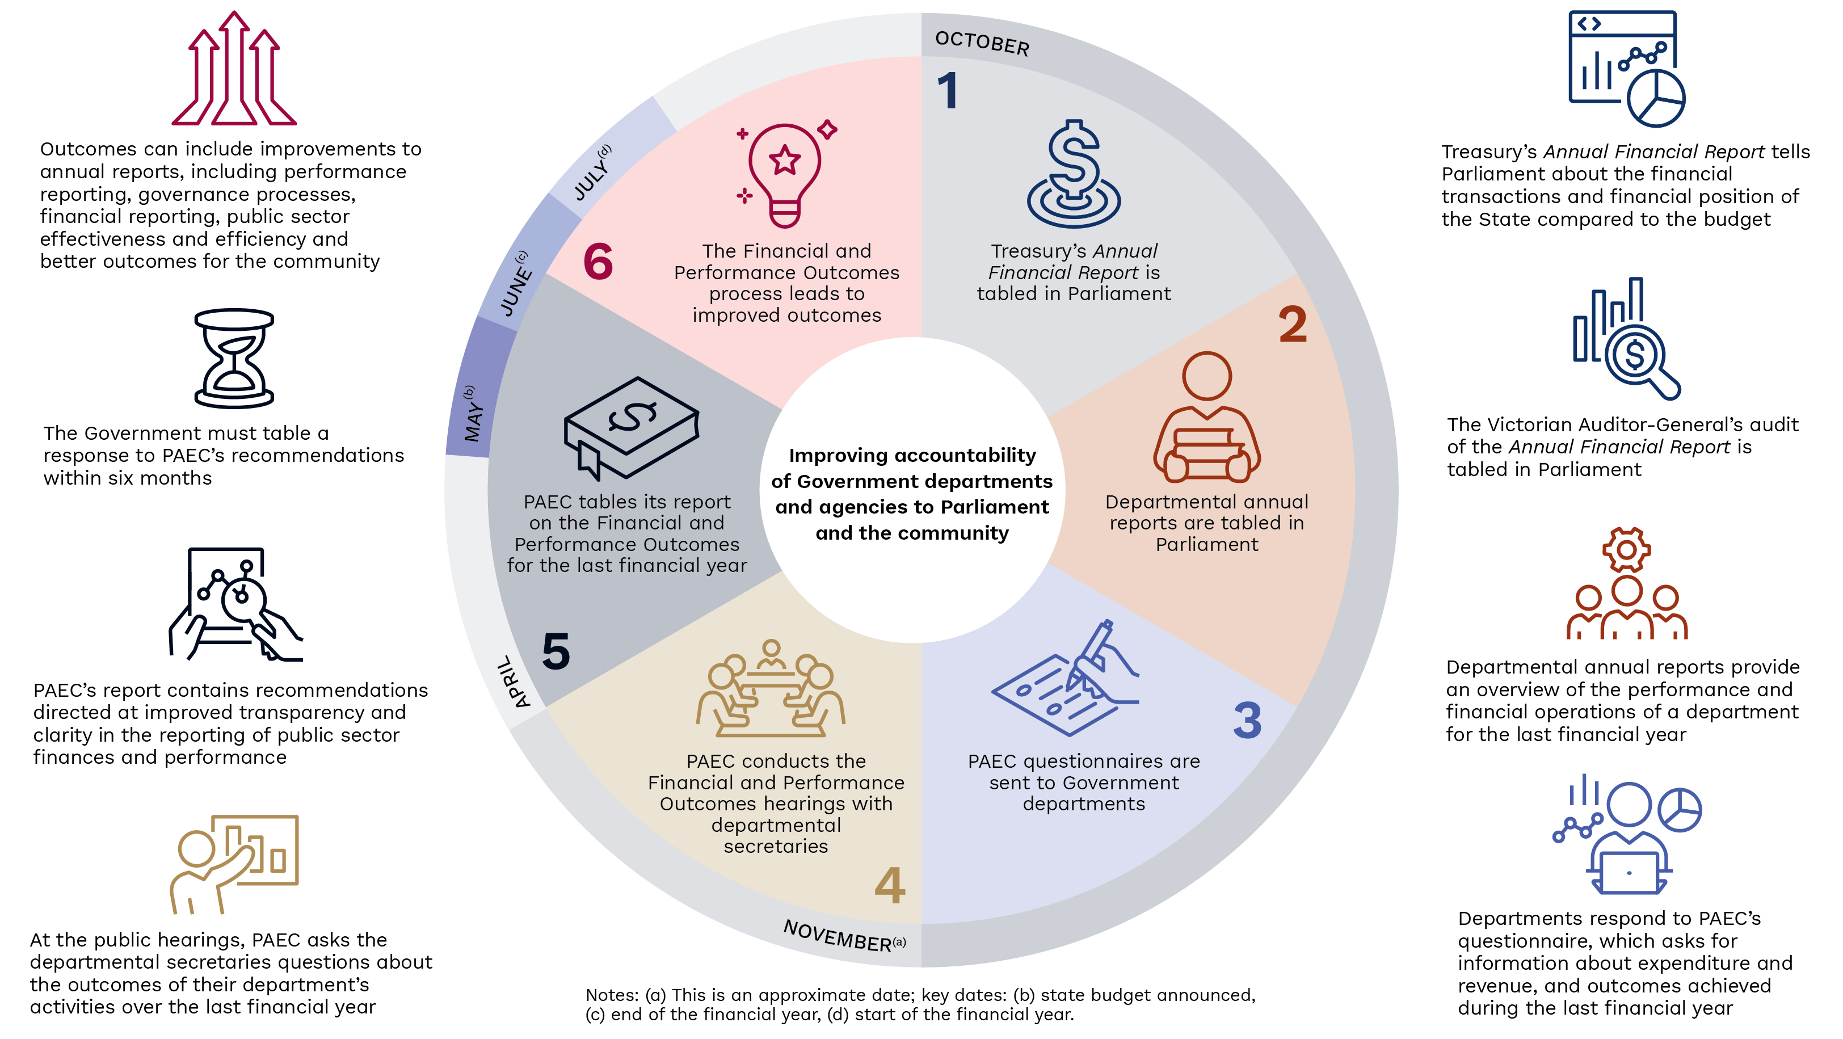
Notes:
Scrutinising the Victorian Government’s expenditure, revenue raised and outcomes delivered is a core function of the Public Accounts and Estimates Committee and is undertaken on an annual basis.
This work is important because it strengthens the accountability of government departments and agencies to the Parliament and the Victorian community.
The Committee’s latest report, tabled in March 2024, covers not one, but two financial years (2021–2023), due to the state election that was held in November 2022. Government departments and public sector agencies spent approximately $190 billion in 2021–22 and 2022–23.
The Committee’s report contains analysis of Victoria’s progress in Closing the Gap as well as the State Government’s performance in relation to Aboriginal and Torres Strait Islander children in care.

Slide 5
Closing the Gap: the Committee’s findings
Notes:
This information was updated as of March 2024 and therefore differs slightly to the information in the 2021-22 and 2022-23 FPO report.

Slide 6
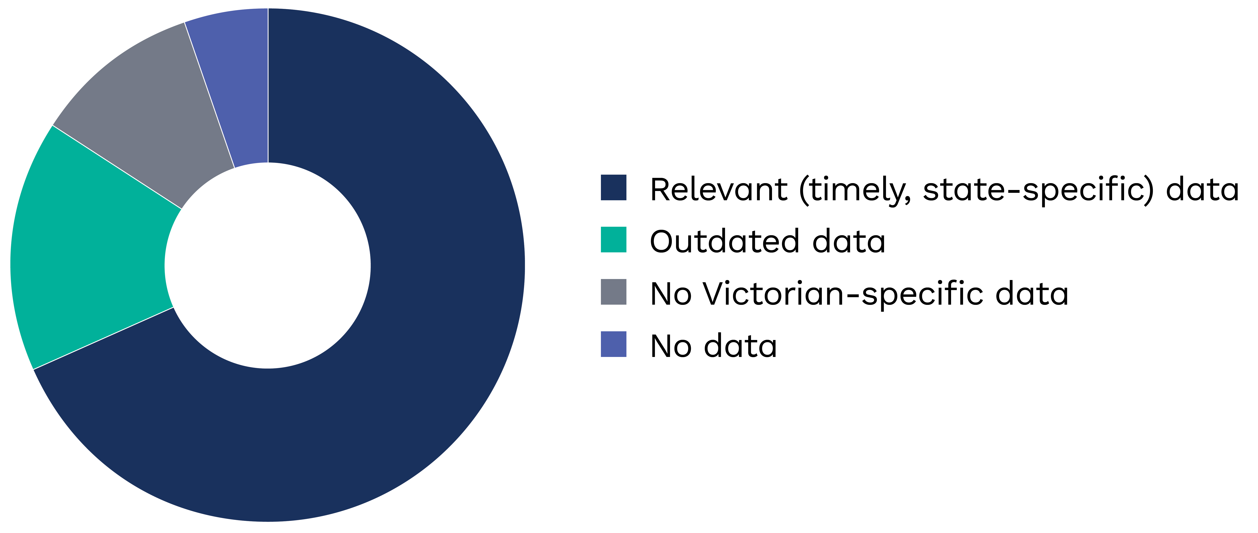
Status of data
Notes:
Responsibility for development of Victoria’s Closing the Gap Implementation Plan sits with the Department of Premier and Cabinet.
The Productivity Commission plays a key accountability role by producing the information repository that tracks progress toward the Agreements priority reforms and socio-economic outcome areas.
The Committee found that relevant data is only available to measure Victoria’s progress against 13 of the 19 targets under the Closing the Gap Agreement.
The Commission does not have:
Updated data for all states and territories across three target areas relating to: family violence, culture and languages and digital inclusion. This data is more than five years old.
Victorian-specific data for two target areas relating to: life expectancy and suicide.
Data from any jurisdiction on one target area 9B relating to: households receiving essential services

Slide 7
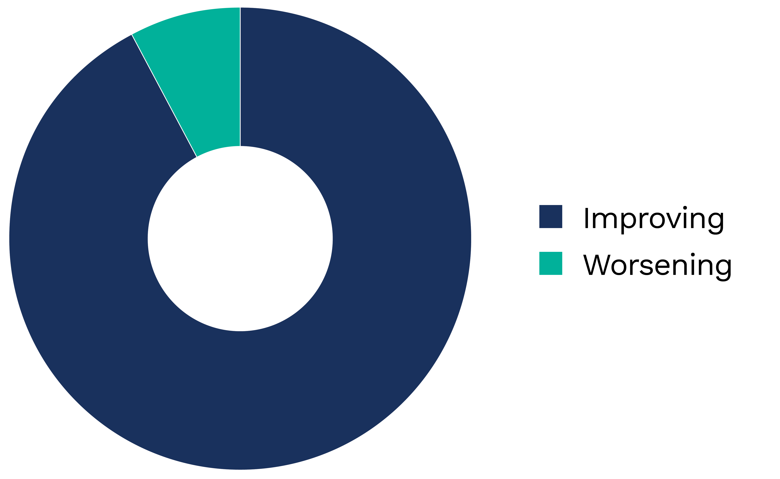
Performance – where data is available
Notes:
Of the 13 targets where relevant data is available, Victoria is worsening in one (children in the child protection system) and improving in 12. I will return to the issue of children in the child protection system later.
According to the most recent data, Victoria is improving in a number of outcomes including:
• Target 2: increasing the proportion of Aboriginal and Torres Strait Islander babies with a healthy birthweight to 91%
• Target 3: increasing the proportion of Aboriginal and Torres Strait Islander children enrolled in Year Before Full time Schooling (YBFS) early childhood education to 95%
• Target 8: increasing the proportion of Aboriginal and Torres Strait Islander people aged 25–64 who are employed to 62%
• Target 9A: increasing the proportion of Aboriginal and Torres Strait Islander people living in appropriately sized (not overcrowded) housing to 88%

Slide 8
Department of Premier and Cabinet’s evidence
DPC’s role
Victoria’s results are ‘quite mixed’
‘frankly we have still got more work to do’
Notes:
DPC’s role in Closing the Gap is to lead, coordinate and report on whole‑of‑Victorian‑government (WoVG) actions to advance the reform areas, as part of its objective that ‘First Peoples in Victoria are strong and self‑determining’.
Victoria’s current results towards Closing the Gap, notably in comparison to the national or other states and territories’ results, are ‘quite mixed’ according to DPC.
DPC has acknowledged that while ‘we have achieved some good outcomes in some of the 19 targets under Closing the Gap … frankly we have still got more work to do in a number of those areas’.
DPC noted several successes that Victoria has had regarding the national targets, including healthy birth weights, early childhood education enrolment and appropriate housing.
DPC also stated areas that Victoria needed to improve on, including early childhood development levels and out‑of‑home placement numbers.

Slide 9
Children in out of home care

Slide 10
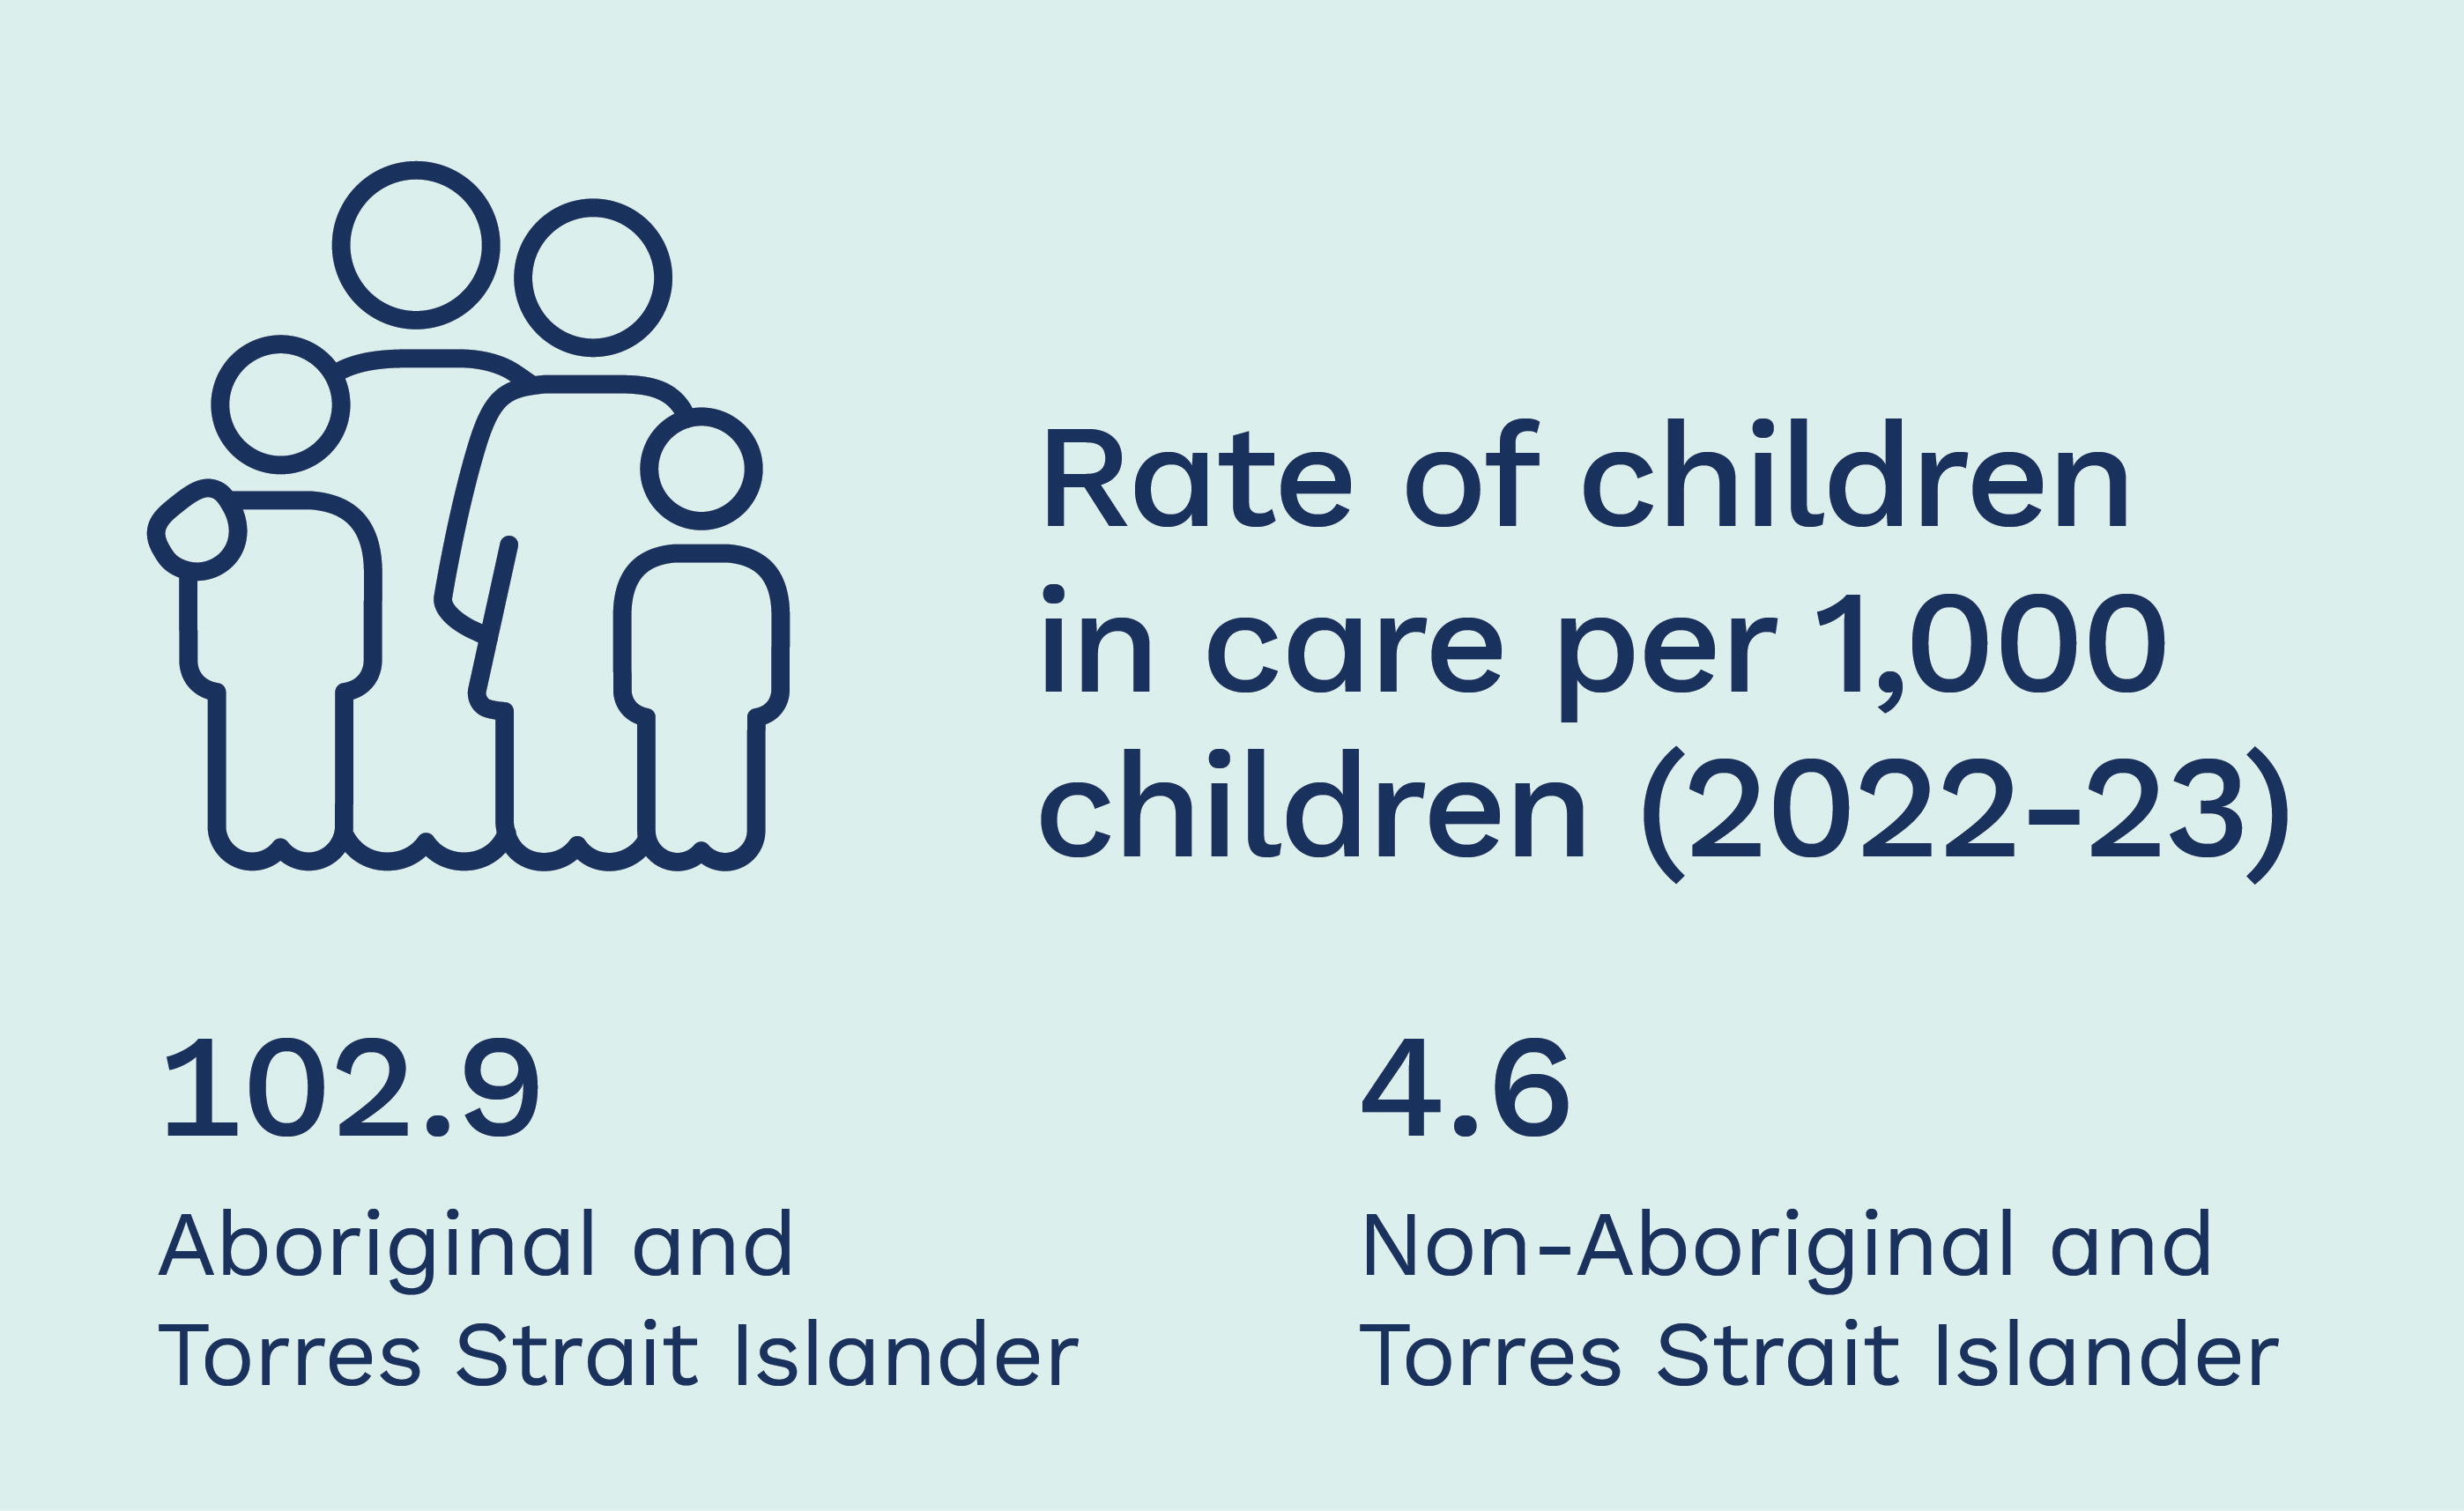
Committee’s findings
Aboriginal and Torres Strait Islander children are vastly overrepresented in the Victorian child protection system.
The department’s partnering with Aboriginal Controlled Community Organisations is resulting in higher success rates in family reunification as well as retaining vital cultural and community connections.
Notes:
The Committee found that Aboriginal and Torres Strait Islander children are vastly over represented in the Victorian child protection system.
The Department of Families, Fairness and Housing acknowledged during the hearings that it had ‘a long way to go in terms of addressing the rates of over-representation’.
The Victorian Government has committed to reducing the rate of ATSI children in out-of-home care by 45% by 2031.
One of the ways it has been doing this is partnering with Aboriginal Community Controlled Organisations. DFFH has been transitioning Aboriginal and Torres Strait Islander children in care to the management of ACCOs since 2016–17. According to DFFH, the management of cases by ACCOs has led to positive results in two ways: children feel more connected to culture and community and children are more likely to be reunified or safely returned to live with their parents.
The data supports this—reunification rates for Aboriginal children from 2017 to 2020 were 15.6% when managed by an ACCO and 12.9% when managed by DFFH. Since the initiative’s inception there has been a 250% increase in the proportion of Aboriginal children and young people who are managed by ACCOs.
The department has also accepted a Committee recommendation to report on the number of Aboriginal children in out of home care managed by ACCOs, adding the performance measure to the Budget Papers: ‘Number of children authorised to an Aboriginal agency under the Aboriginal Children in Aboriginal Care program’. This will provide greater transparency regarding the progress being made in this important policy area.

Slide 11
Voice, treaty and truth telling

Slide 12
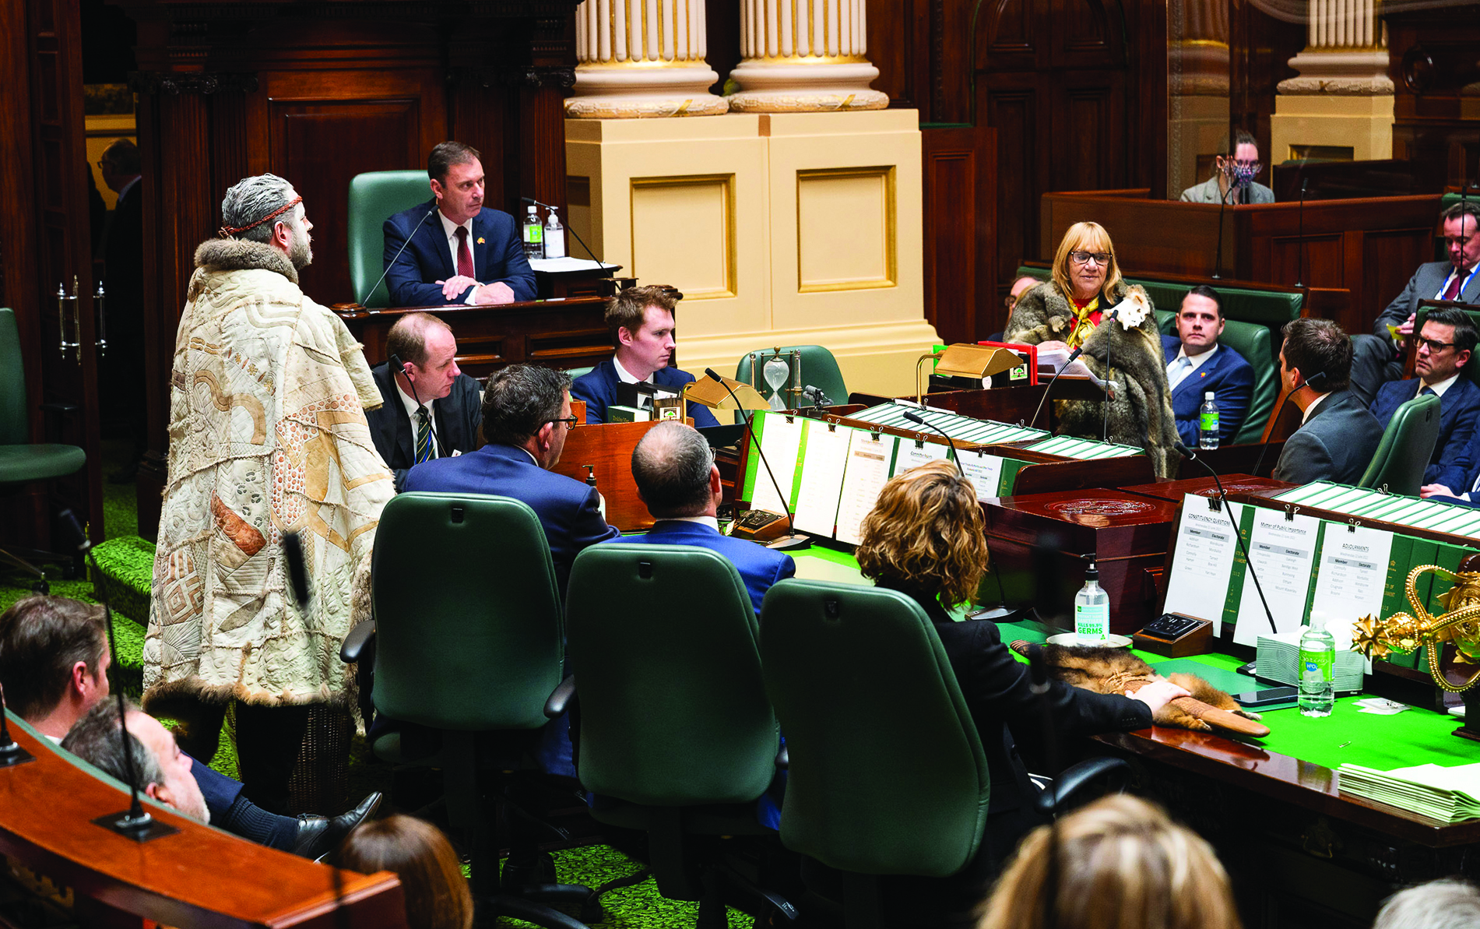
Recent developments
First Peoples’ Assembly Co‑Chairs Mr Marcus Stewart and Aunty Geraldine Atkinson addressing the House on 22 June 2022. Photo by Janusz Molinski Photography.
Notes:
Finally before we go to questions, I would like to note that there are some important developments occurring in Victoria in relation to treaty and truth telling.
The First Peoples’ Assembly of Victoria has been established as the independent and democratically elected body to represent Traditional Owners of Country and Aboriginal and Torres Strait Islander peoples in Victoria.
The Victorian Government has made a commitment to negotiate Treaty with Victoria’s First Peoples.
To inform the treaty process the Yoorrook Justice Commission is investigating injustice against First Peoples in Victoria since colonisation. In mid-2023 Yoorrook released the Yoorrook for Justice report into the Victorian child protection and criminal justice systems. Yoorrook is now looking into land, sky and waters, health, housing and education, and economic prosperity. Yoorrook will deliver its final report in 2025.

